Slide 1
Pilot Certificates
Student Pilot: A pilot in training
Sport Pilot: A Pilot authorized for fly Light Sport Aircraft only (LSA) .
Private Pilot: Pilot may fly for pleasure and business but can't get paid
Commercial Pilot: Get paid to fly
Airline Transport Pilot (ATP): A pilot who flys for a scheduled airline or very large airplane.

Slide 2

Notes:
Don't do stupid.
Don't post stupid on social media.

Slide 3
Careers in Aviation
In the Air - Pilot
Airline
Corporate/Cargo
Military
Agriculture
Flight Instructor
Flight Attendant
On the Ground
Air Traffic Controller
Aircraft Mechanic
Aircraft Builder
Airport Manager
Ramp Rat
Notes:
Mention education for each topic.
Ag pilot – same excitement as a jet fighter pilot but no one shooting at you!

Slide 4
More Careers in Aviation
Engineering
Aerospace
Civil
Chemical
Mechanical
Electrical
Software
Notes:
Mention education for each topic.
Ag pilot – same excitement as a jet fighter pilot but no one shooting at you!

Slide 5
Rules for Airport & Airplane Safety
Stay away from propellers
Stay off of runways and stay clear of taxiing aircraft
Wear seatbelt at all times
Obey all instructions from the pilot & ground crew
In general, do not touch aircraft
When entering and exiting an aircraft, watch for “NO STEP” signs
Don’t bother the pilot during take-off and landing

Slide 6
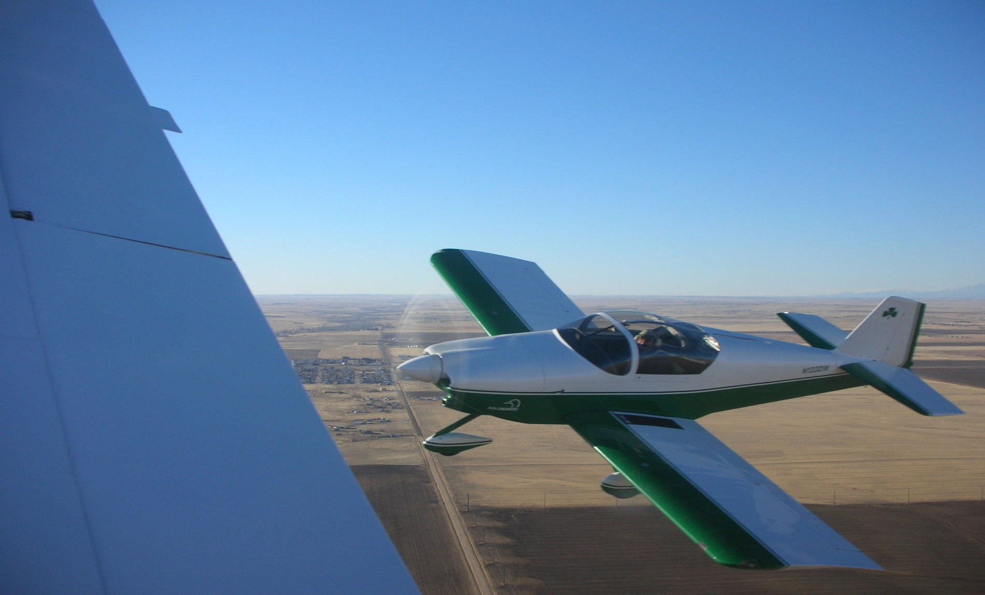
A Picture Preview of your Young Eagle Day
Notes:
We start flying about 8 am.
Rudy will be at the table, bring your filled out & signed form to him.
Rudy will call you up, 2 at a time to the table.
You'll be escorted to the airplane.
Do NOT step on the wheel pant - it's for decoration.
Only step where the pilot tells you.
You do not have to fly, it's your choice.
You can have just as much fun enjoying the scenery from high above.
Do not let anyone embarass you or tease you - it's your choice.
Reverse Peristalsis.

Slide 7
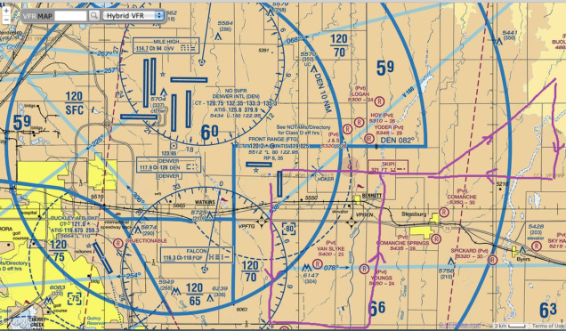
Where we'll be flying
Notes:
How do we know? We read maps. If I want to fly to Salida, I need to go over the foothills. The tops are about 10,000 ft above SL, so I want to be 2000 ft above that, or 12,000 ft.
Show the Denver Terminal and the YE map.

Slide 8
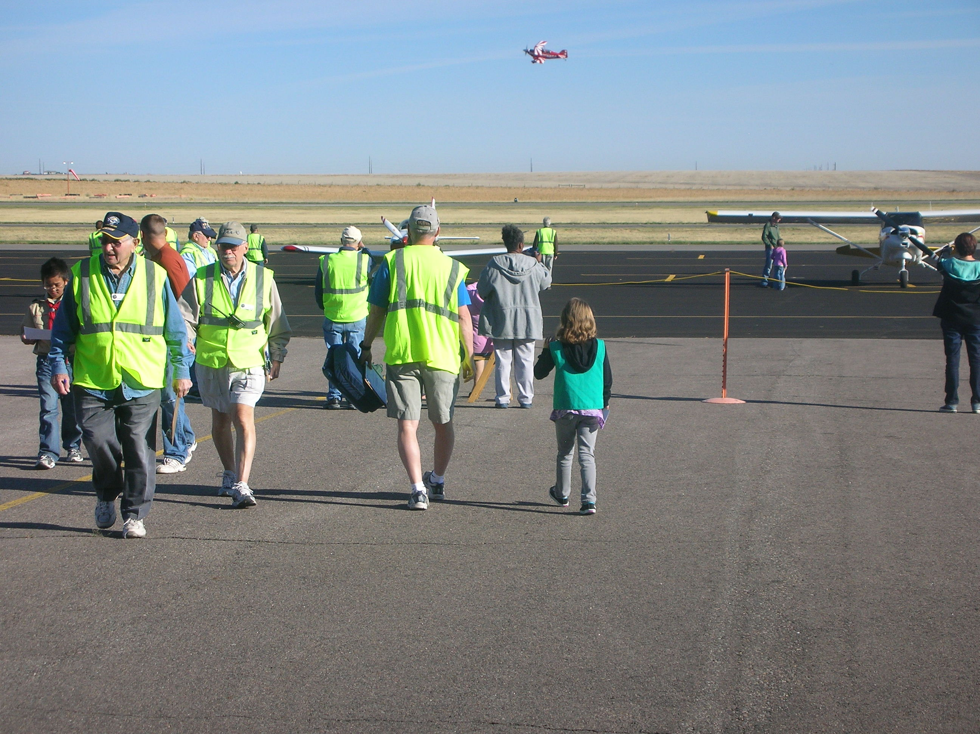
Notes:
You'll be escorted to the airplane.

Slide 9
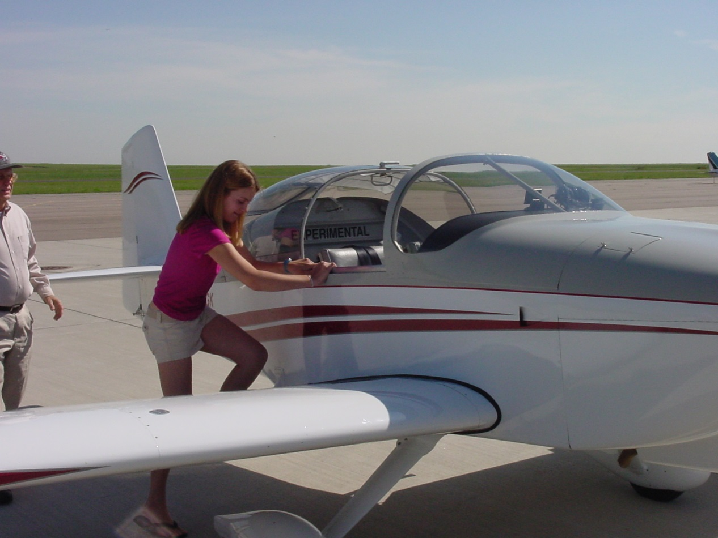
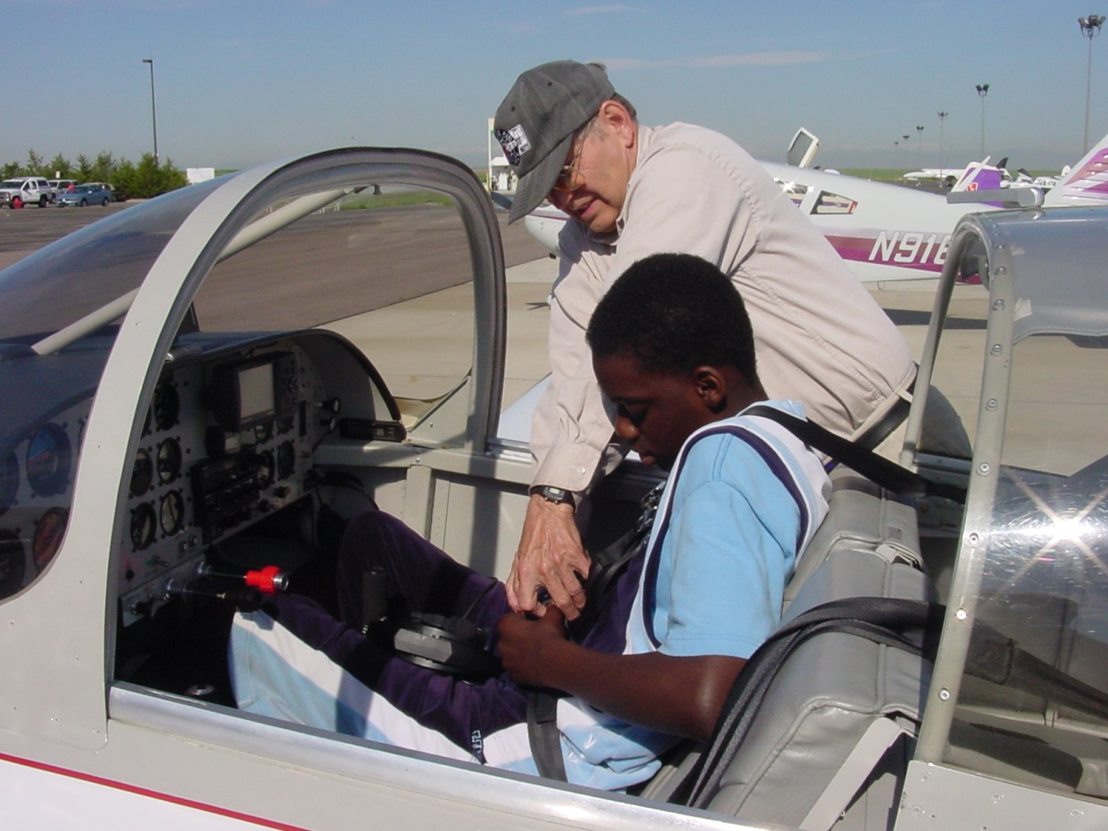
The Pilot will help you into the plane and make sure your seatbelt is secure.
Some airplanes have doors – others are "convertibles" and the climb in thru the "roof"
Notes:
Do NOT step on the wheel pant - it's for decoration.
Only step where the pilot tells you.
You do not have to fly, it's your choice.
You can have just as much fun enjoying the scenery from high above.
Do not let anyone embarass you or tease you - it's your choice.

Slide 10
What's Wrong with this picture?

Slide 11
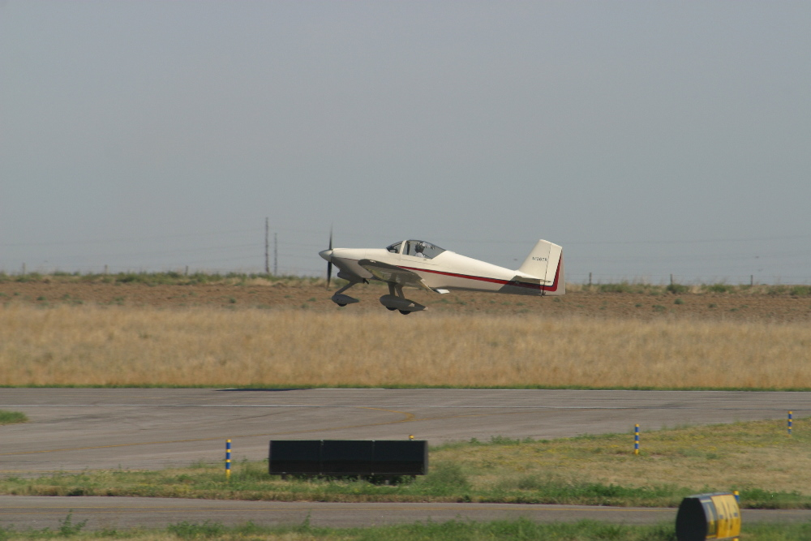
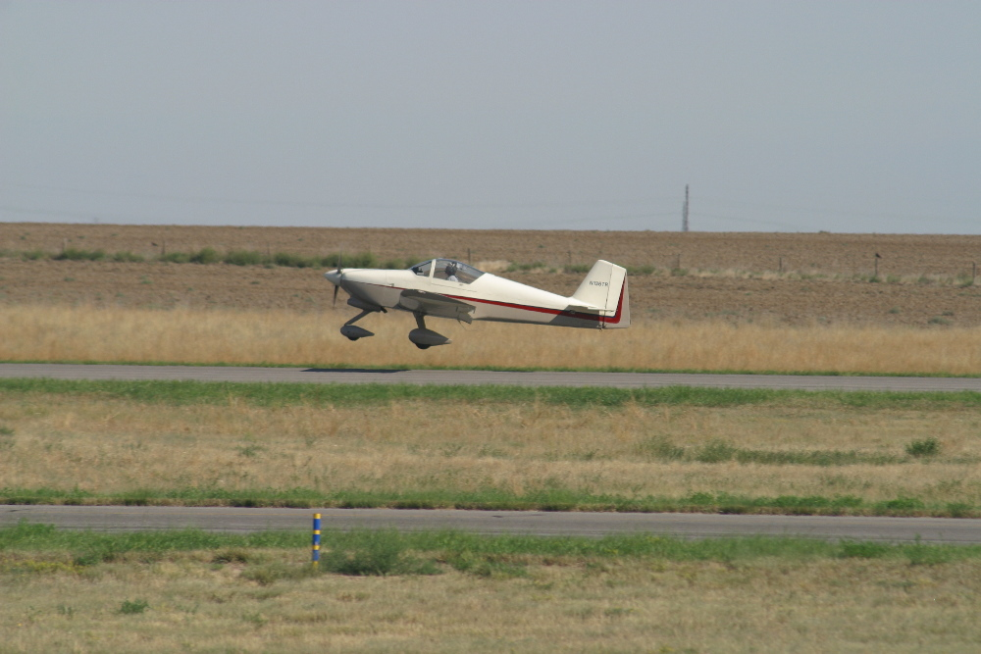
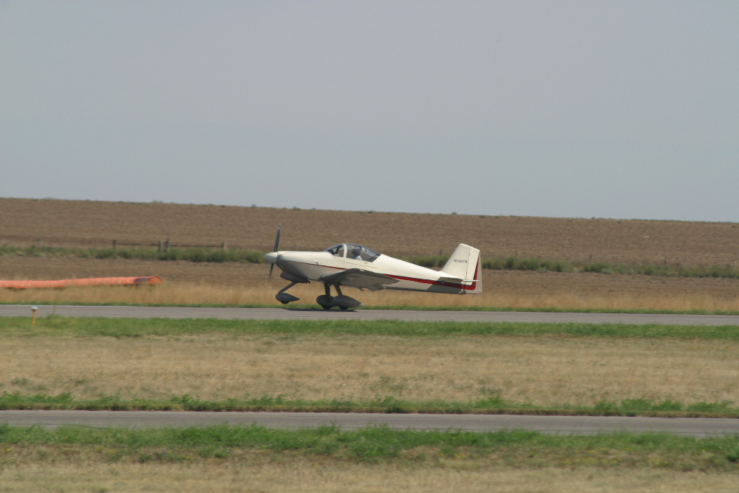
Time to fly!
Up, Up & Away!

Slide 12
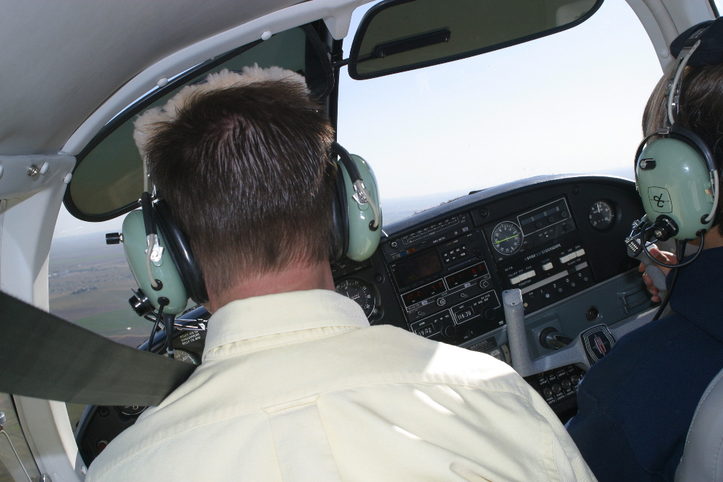
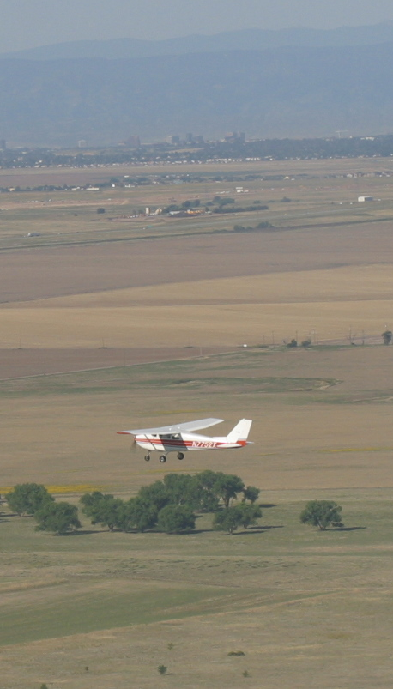
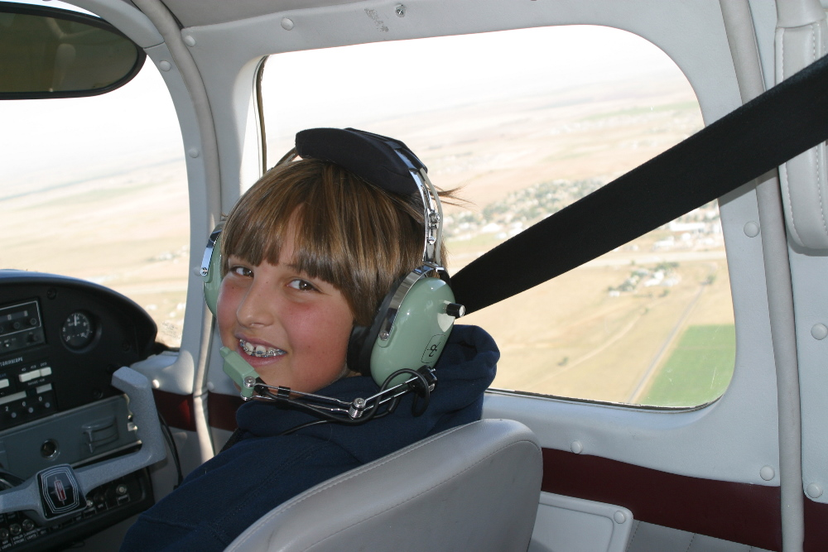
In the Air

Slide 13
Why can't I sit inside the airplane?

Slide 14
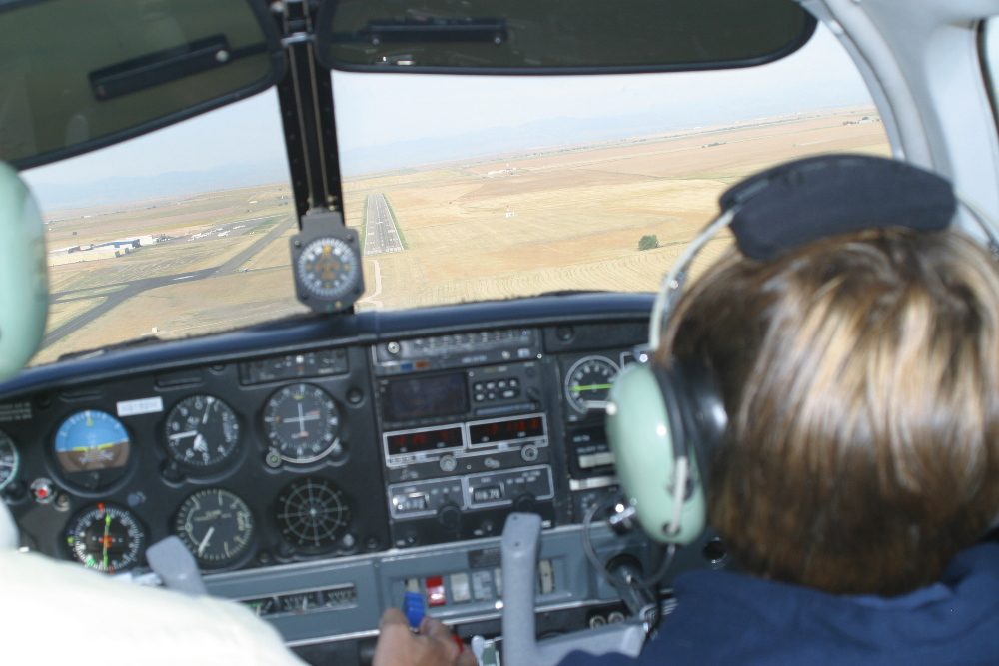
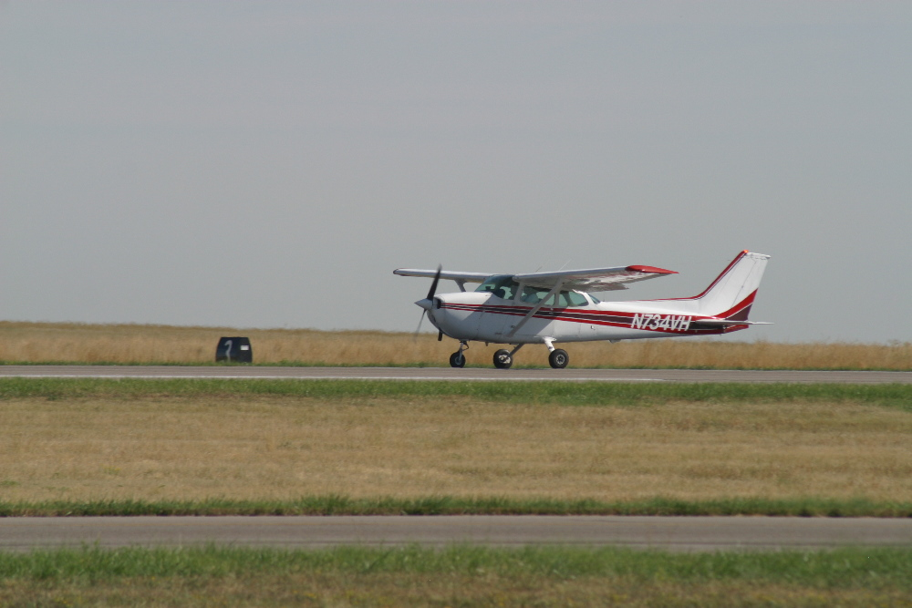
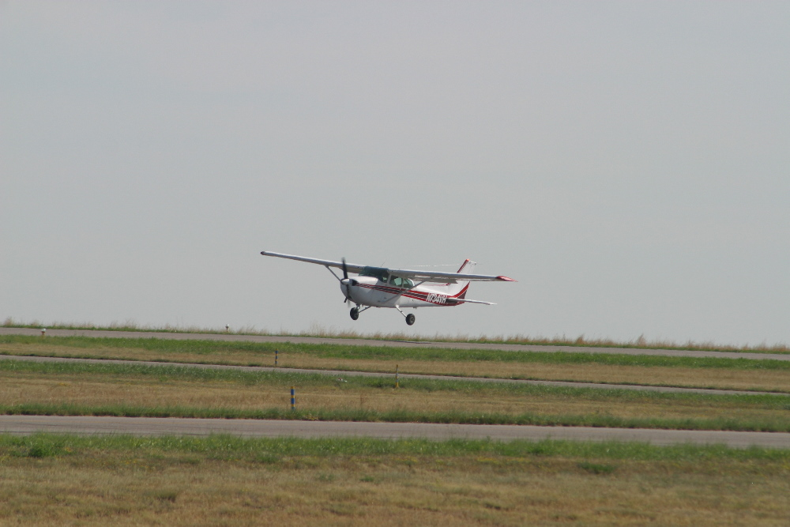
But at some
point, you
have to
come back
to land

Slide 15
Good landings vs Great Landings?

Slide 16
Good landings vs Great Landings
Good landing: Any landing that you can walk away from
Great Landing: Any landing that you can re-use the airplane ☺

Slide 17
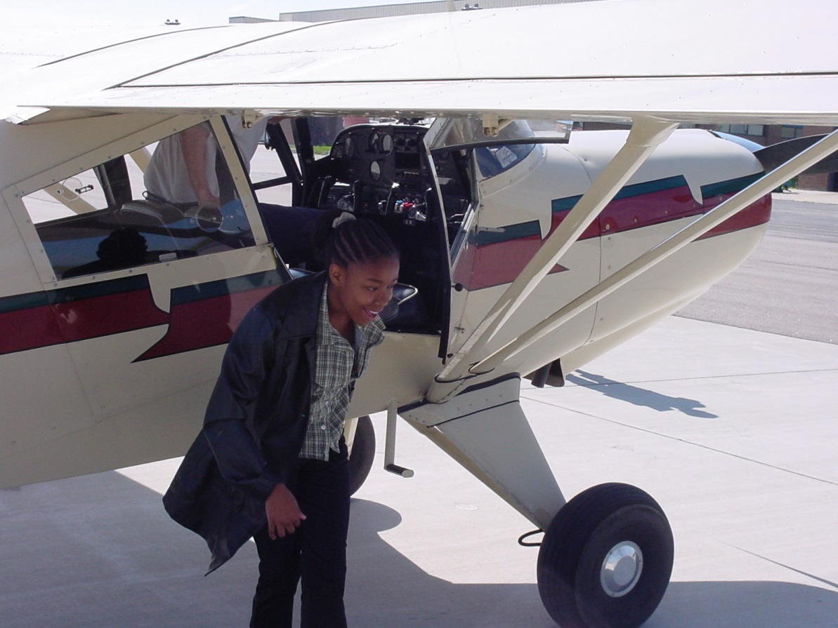
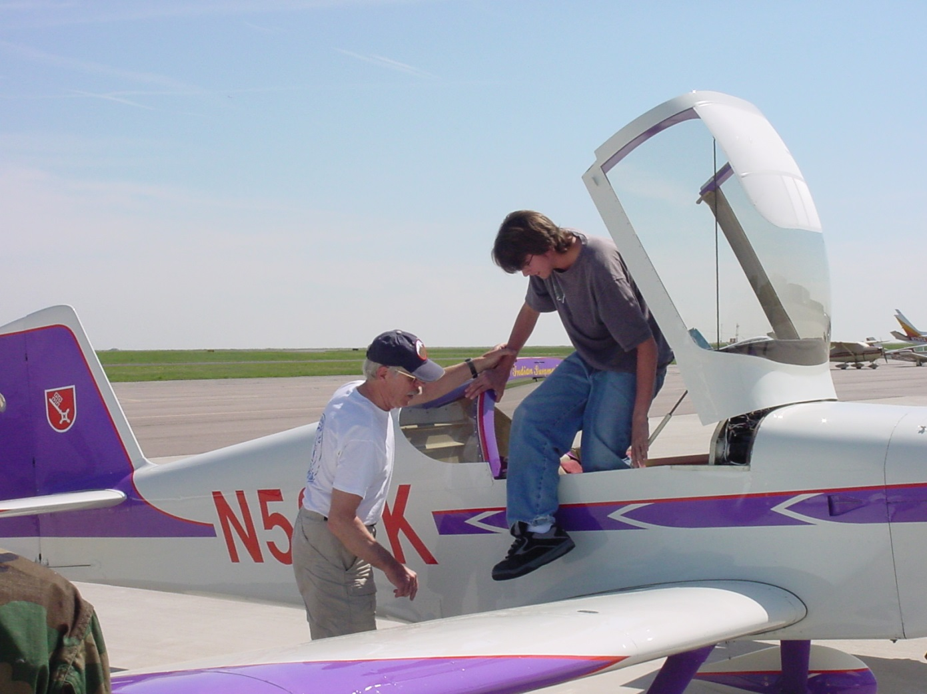
After the flight, watch your step getting out.

Slide 18
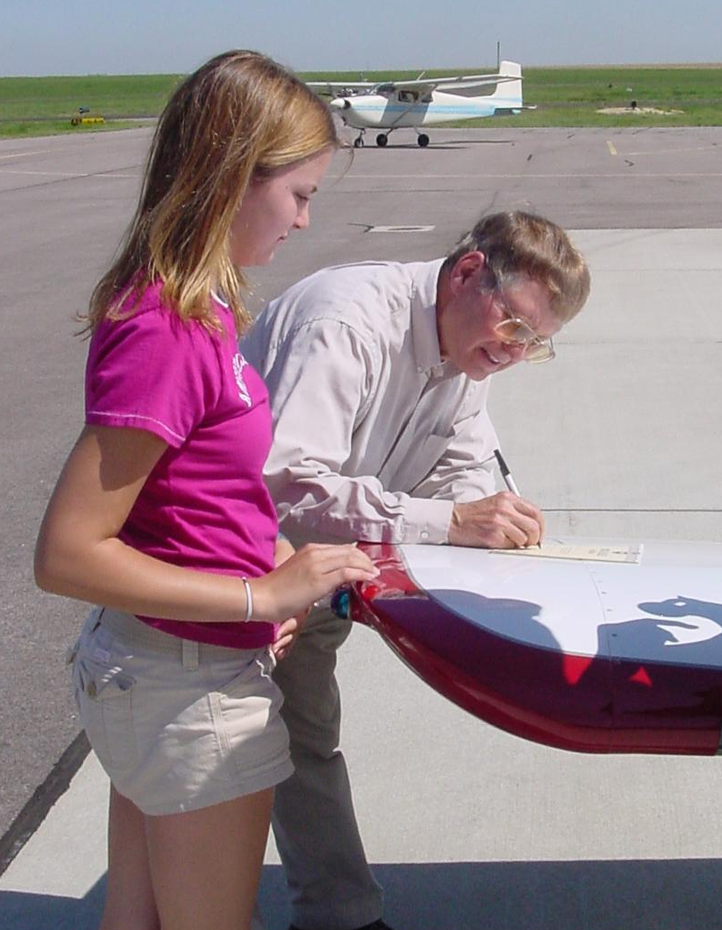
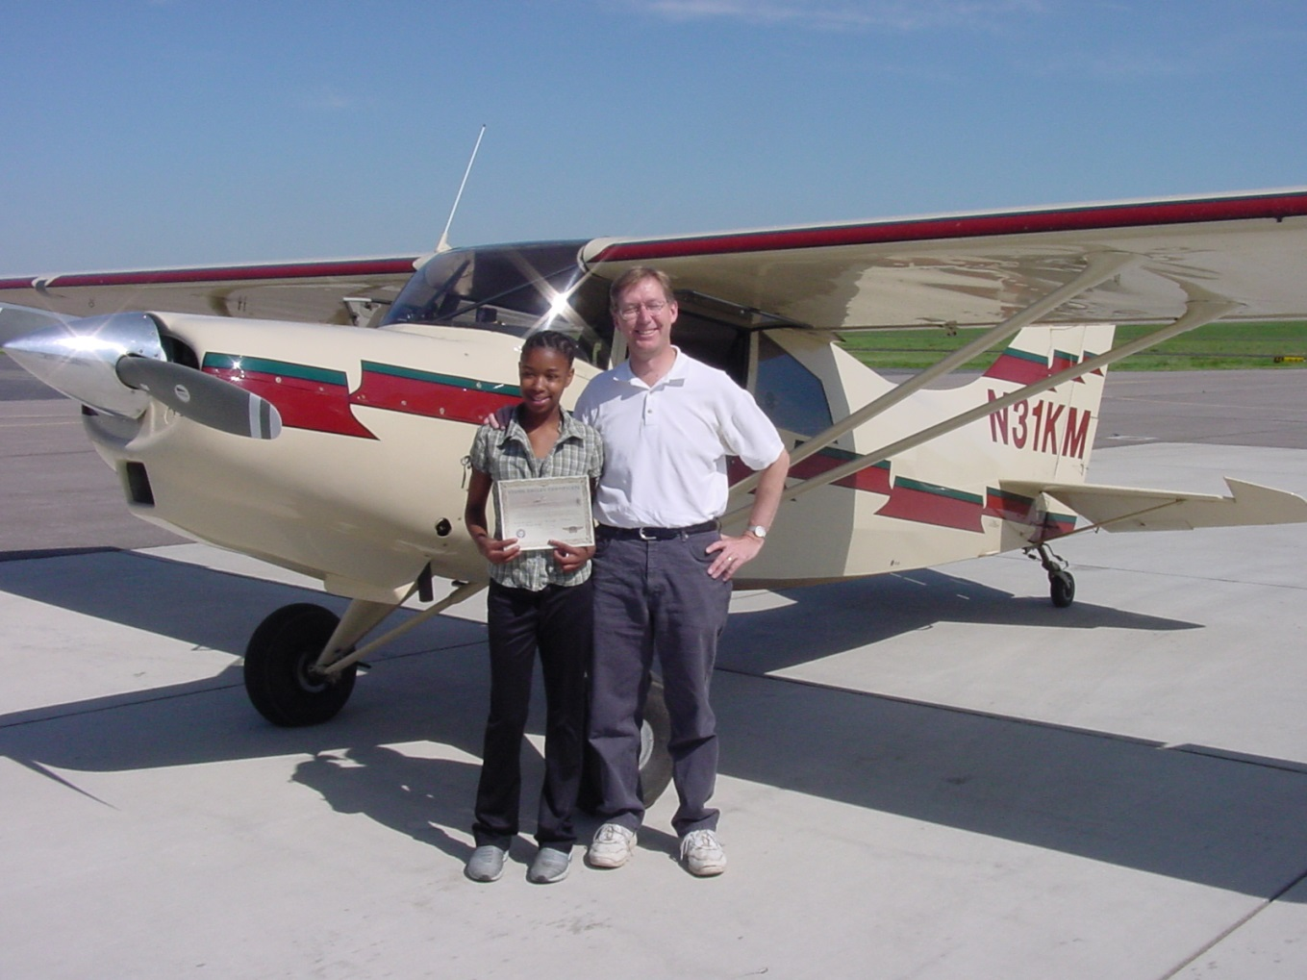
After your YE flight
Your pilot will sign your certificate.
Our photographer will take photos of you, the pilot & the airplane
Notes:
What's on the cert?
Pilot, N number, date, airplane, etc.
You can always look up the airplane on the FAA website.

Slide 19
Sporty’s Log Book
After your flight go back to the classroom and get your Sporty’s log book

Slide 20
Where is your photo?
In a week or two, go to our website:
www.eaa301.org
Under Young Eagles Program click on “Young Eagles Images 2023”
Look for date of your flight, should be at top, and click on image to left for all photos.

Slide 21
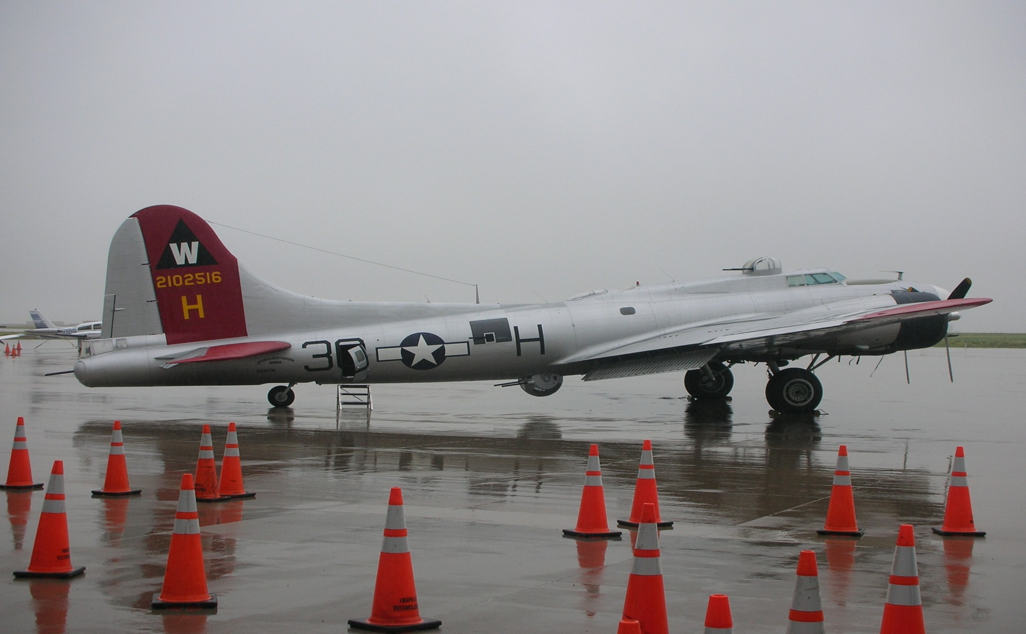
THE END – GO HAVE FUN!

